Slide 1
Unit 4 Shopping
购物

Slide 2
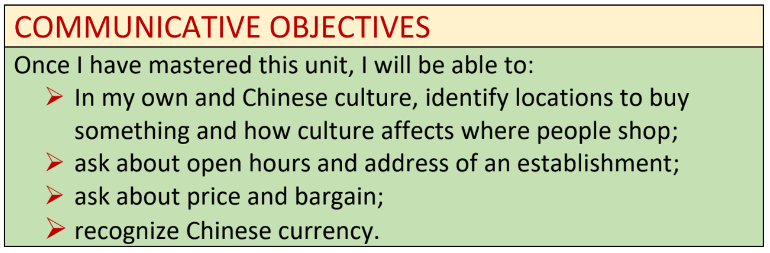

Slide 3
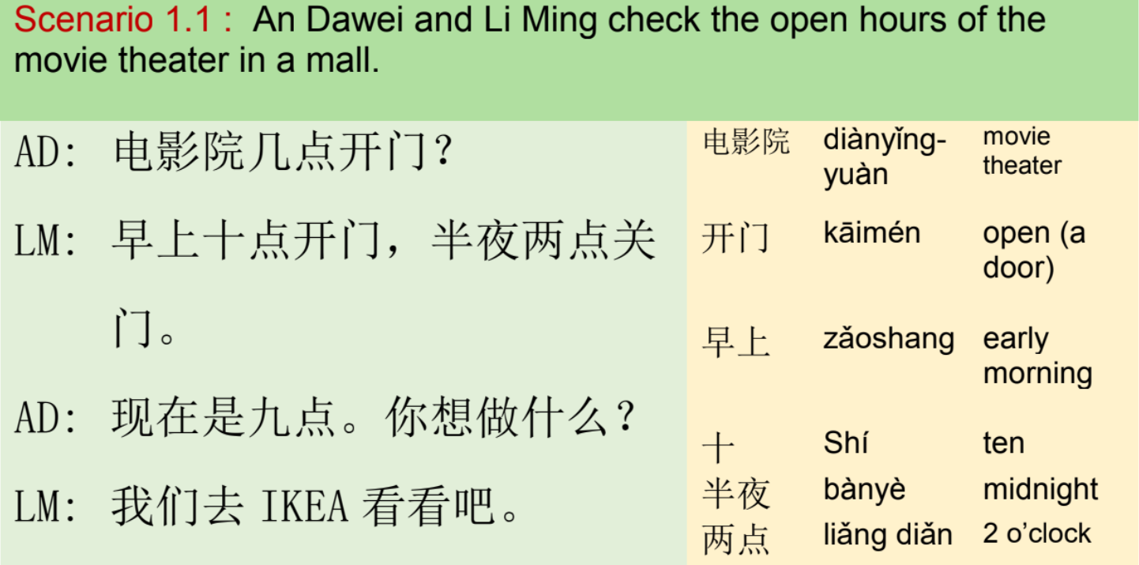

Module I : Open Hours 模块一：营业时间

Slide 4
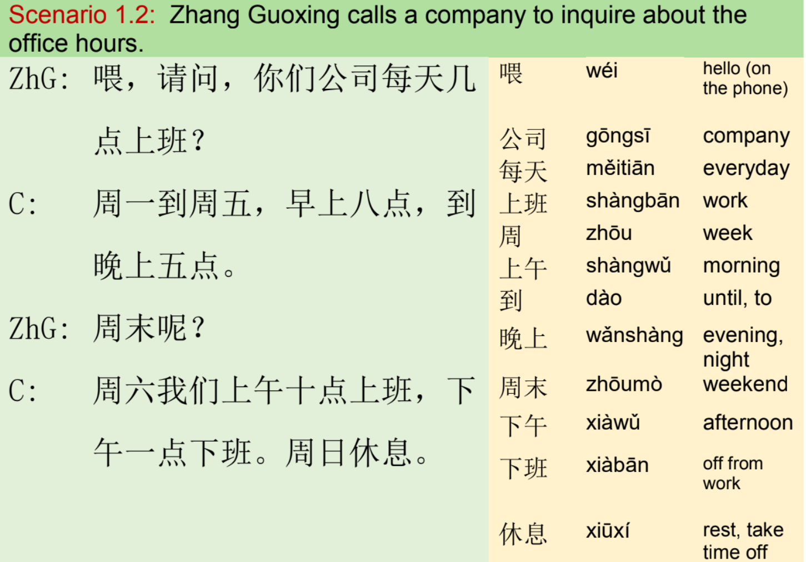
Module I : Open Hours 模块一：营业时间

Slide 5
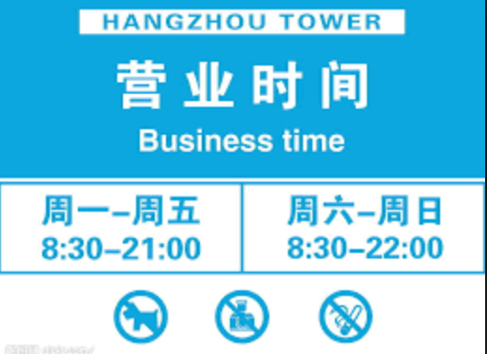
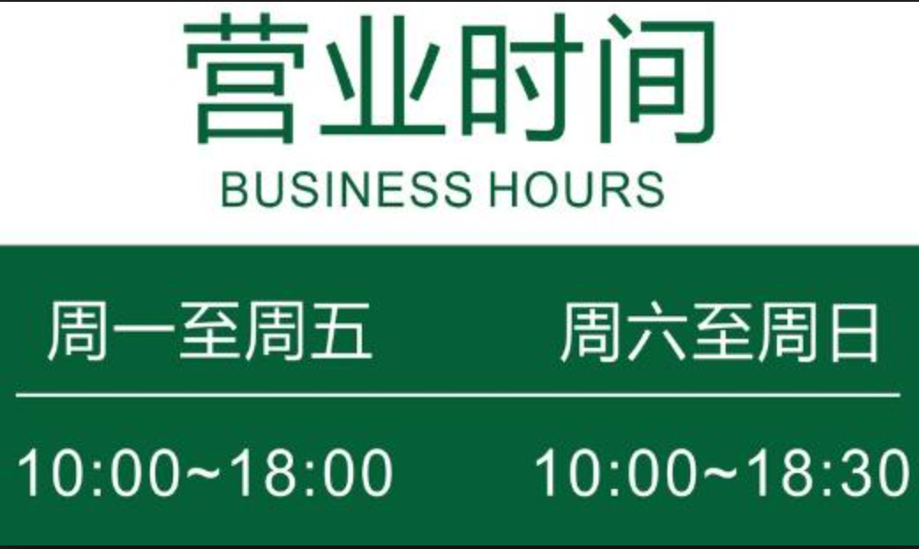
Exercise
Communication:
Students pair up Students ask questions to find out the info that fill in the form.
Questions:
-X几点开门？
X每天都开门吗？
X星期天开门吗？
X哪天开门？
学生A | 学生B

Slide 6
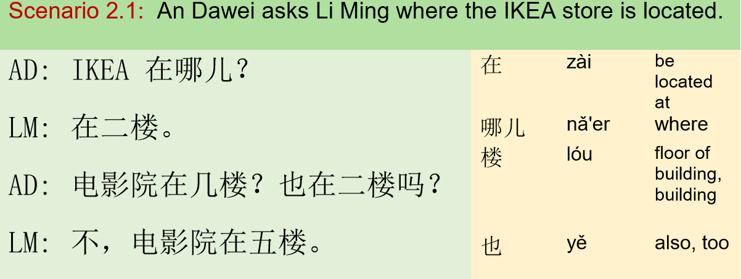
Module II: Address 模块二：地址

Slide 7
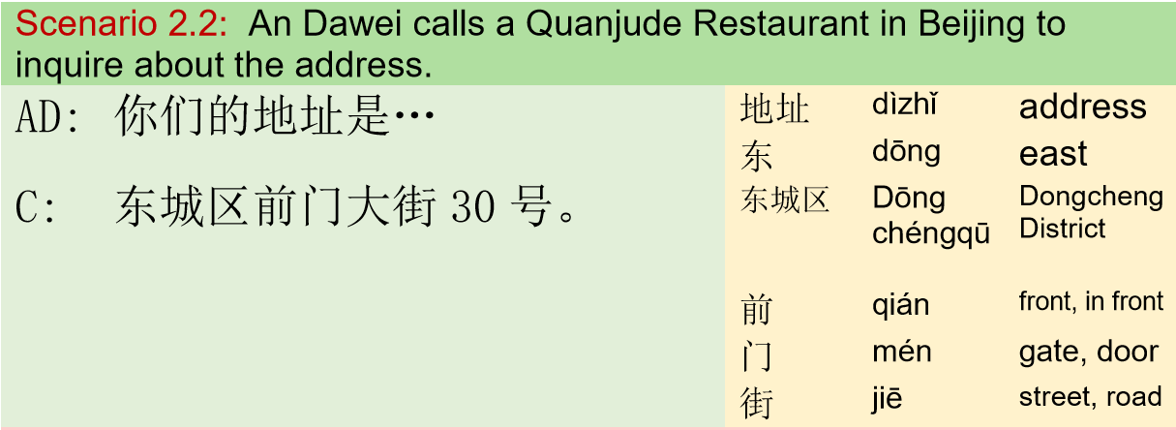
Module II: Address 模块二：地址

Slide 8
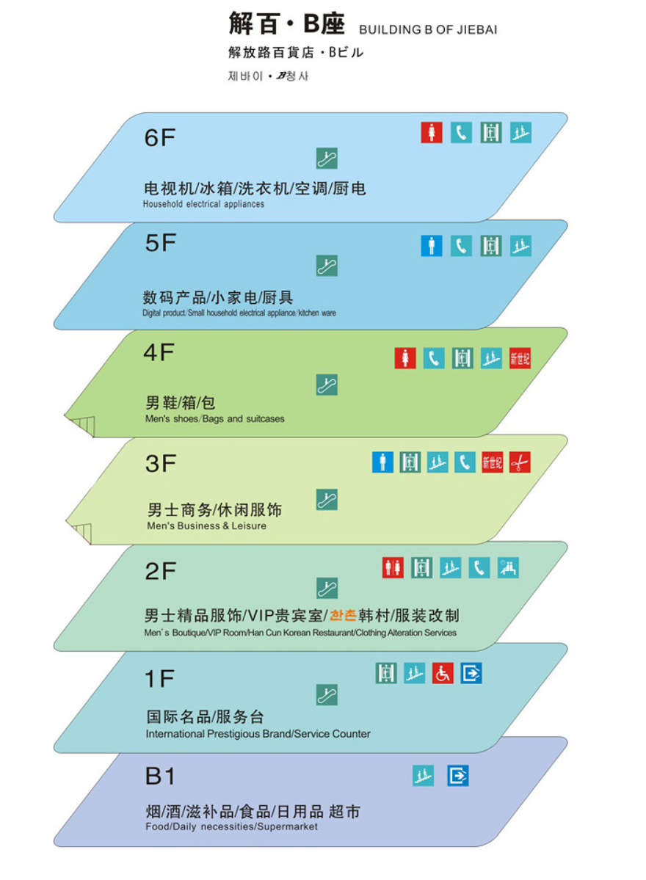
Exercise
Communication:
Students pair up Students ask questions to locates the following items, Student A: 电视机、背包、啤酒 Student B: 冰箱、裤子、面包

Slide 9
Exercise
Communication:
Students search the address of the following establishments. U.S. Embassy in Beijing, China The Palace Museum in Beijing, China The Oriental Pearl Tower, Shanghai, China Terracotta Warriors and Horses Museum, Xi’an, China

Slide 10
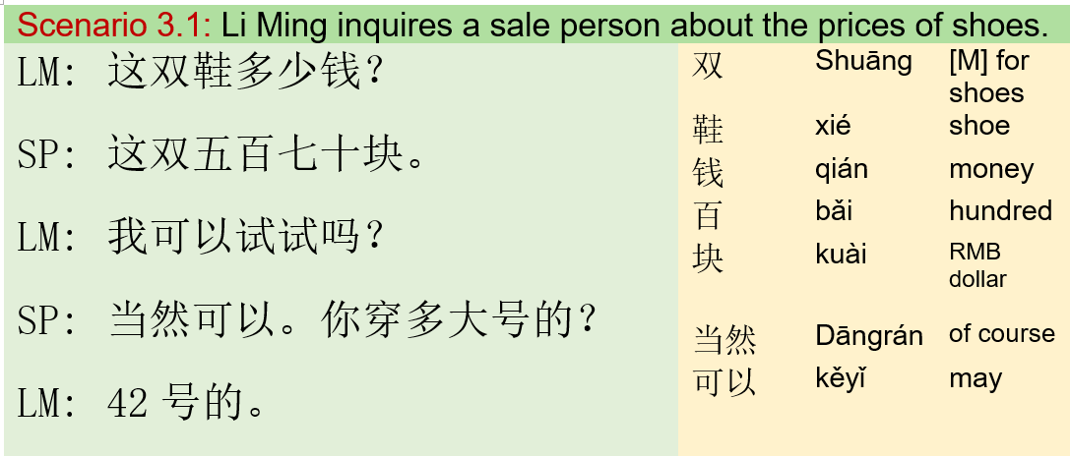
Module III: Shopping 模块三：买东西

Slide 11
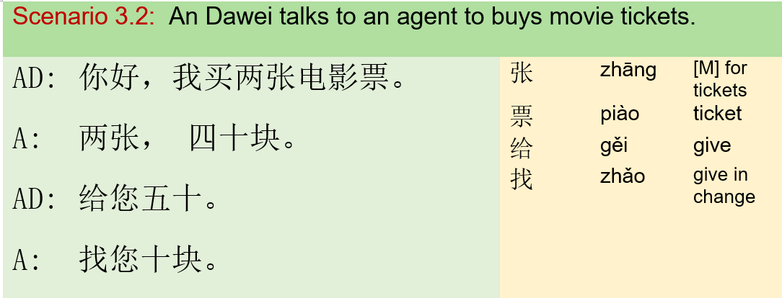
Module III: Shopping 模块三：买东西

Slide 12
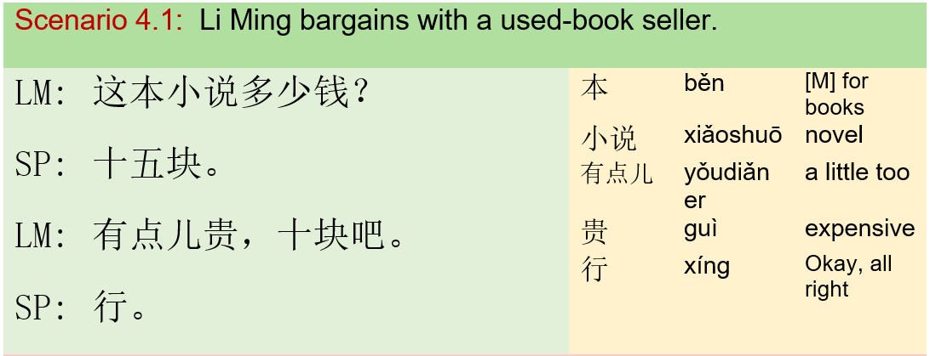
Module IV: Bargaining 模块四：讨价还价

Slide 13
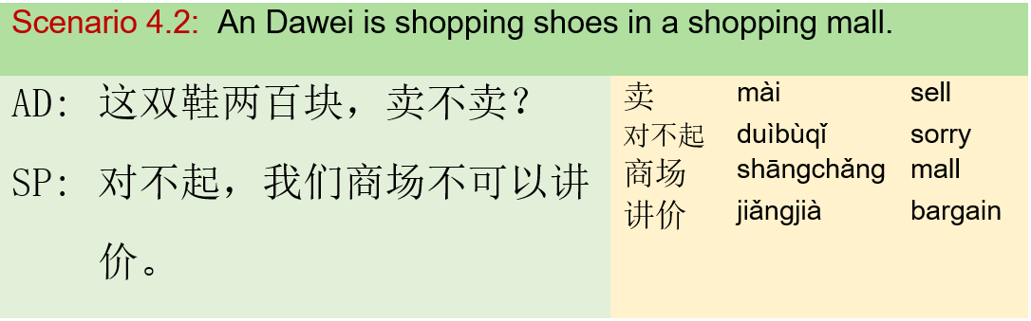
Module IV: Bargaining 模块四：讨价还价

Slide 14
Exercise
Communication:
Students bring their items to resale in class; Put price tag on each items; Use printed Chinese currency to shop; Each student have 200RMB; Students should spend their money, with no more than 30RMB left.

